Slide 1

Eagle, ant and emu
Mark Yettica-Paulson
2026

Slide 2


Slide 3
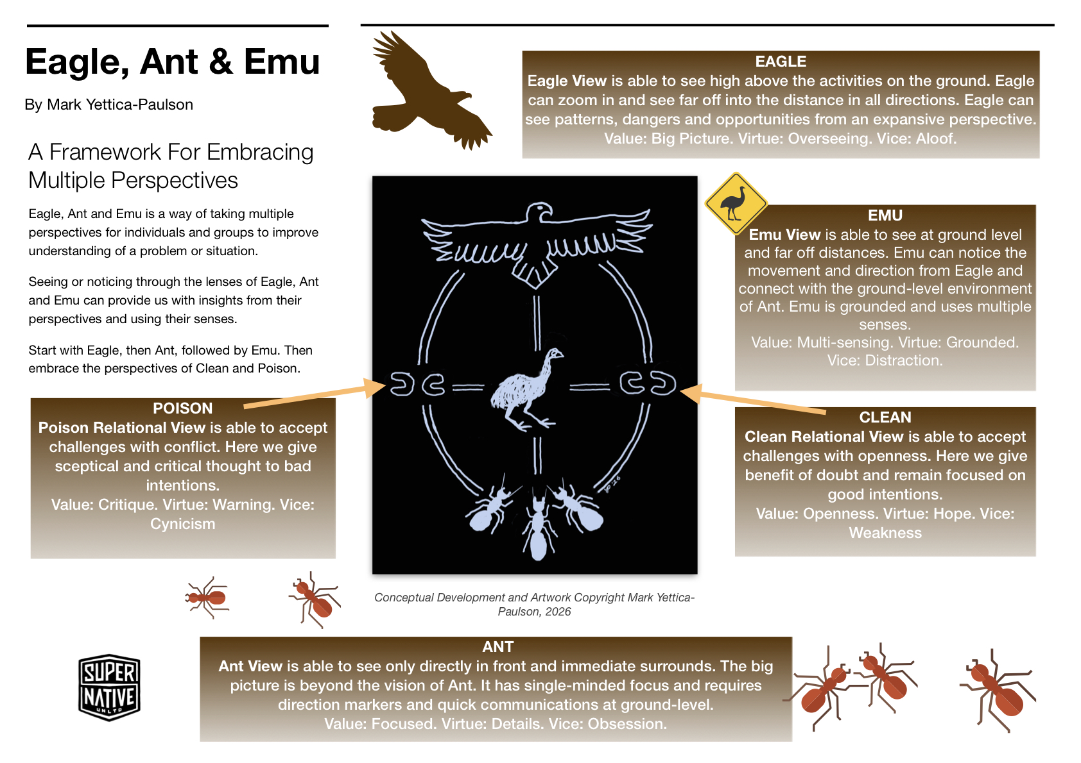

Slide 4
